Slide 1



BANK OF AMERICA'S INNOVATION JOURNEY: A DESIGN THINKING SUCCESS STORY
Life's better when we're connected'
Made By Praneet

Slide 2

INTRODUCTION
WHAT IS DESIGN THINKING?
BANK OF AMERICA'S INNOVATION JOURNEY
CONTENTS
DESIGN THINKING AT BANK OF AMERICA
RESULTS AND IMPACT
CONCLUSION

Slide 3


INTRODUCTION
Design thinking is a non-linear, iterative process that teams use to understand users, challenge assumptions, redefine problems, and create innovative solutions to prototype and test.
Bank of America has used design thinking to develop a wide range of innovative products and services, including Zelle, Erica, Keep the Change, and Small Business Advisor.
Bank of America's innovation journey has resulted in increased customer satisfaction, new products and services, and improved efficiency.

Slide 4
WHAT IS DESIGN THINKING?
Design thinking is a powerful tool that can be used to drive innovation and create products and services that meet the needs of users. It is a human-centered approach to problem-solving that is used by some of the most successful companies in the world.
Design thinking is a way to solve problems by understanding the people who are affected by them.
It puts the user at the center of the design process, ensuring that their needs are met.
Design thinking can be used to create new products and services, or to improve existing ones.
It can help companies to create products that are more user-friendly, efficient, and successful.

Slide 5
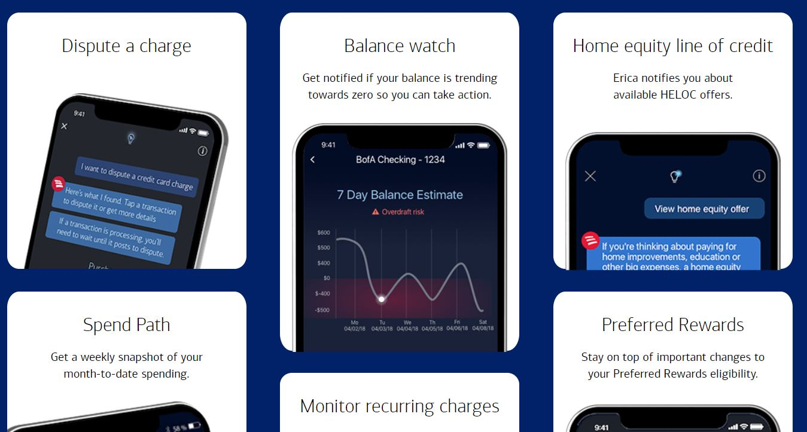
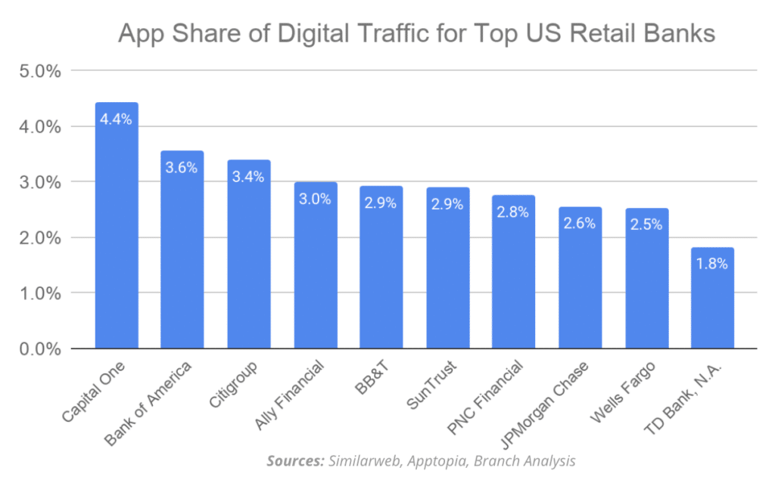
BANK OF AMERICA'S INNOVATION JOURNEY
Bank of America has used design thinking to identify customer pain points and develop solutions that address them in a meaningful way.
For example, Bank of America used design thinking to create its award-winning virtual assistant, Erica.
Through user research and prototyping, the team was able to create a personalized and intuitive experience for customers.
Erica is now used by millions of Bank of America customers to manage their finances and achieve their financial goals.

Slide 6
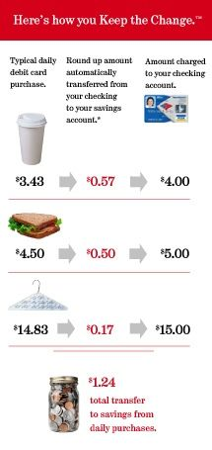
KEEP THE CHANGE PROGRAM BY BANK OF AMERICA
What is Keep the Change?
A unique savings program offered by Bank of America.
Designed to help customers effortlessly save money while making everyday purchases.
How Keep the Change Works
Automated Savings:
Linked to Bank of America checking accounts.
Automatically rounds up debit card purchases to the nearest dollar.
Transfers the "change" into a linked savings account.
Keep the Change - A Win-Win
For Customers:
Build savings without effort.
Track progress and set savings goals.
Enjoy peace of mind and financial security.
For Bank of America:
Increased customer loyalty.
Higher engagement with banking products.
Positive brand association.

Slide 7

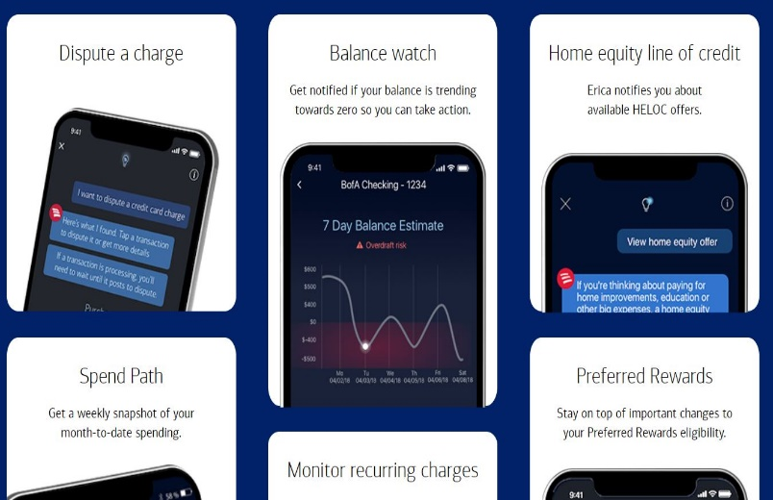

RESULTS AND IMPACT
Since implementing design thinking in its innovation process, Bank of America has seen a significant increase in customer satisfaction and engagement. By putting the customer at the center of its design process, Bank of America has been able to create products and services that truly meet the needs of its customers. This has resulted in increased loyalty and retention rates, as well as higher revenue from cross-selling and upselling opportunities.
In addition to driving customer satisfaction, design thinking has also helped Bank of America streamline its internal processes and reduce costs. By using design thinking to identify inefficiencies and pain points in its operations, Bank of America has been able to implement changes that have led to significant cost savings and improved efficiency. For example, one project aimed at reducing call center wait times resulted in a 20% decrease in average wait time, leading to happier customers and more efficient call center operations.

Slide 8
CONCLUSION
In conclusion, Bank of America's innovation journey has been greatly influenced by design thinking. By using this approach, Bank of America has been able to solve complex problems and create innovative products that meet the needs of its customers.
Design thinking has played a crucial role in driving innovation at Bank of America. The company has implemented various tools and techniques that have helped it to apply design thinking in practice. These include empathy mapping, prototyping, and user testing, among others.

Slide 9

Thanks for watching
Designed & Created By Praneet

